Slide 2

Applied Algorithm Lab
Bridges

Slide 3
Bridges
Find articulation points and bridges of an undirected graph.
Definition: Remove articulation points/bridges -> the number of connected components in the graph increase
Input: Edge list
Line 1 contains N, M
M lines follow, containing a pair of 2 integers a, b which is an undirected edge from a to b.
Output:
Number of articulation points and the number of bridges.

Slide 4
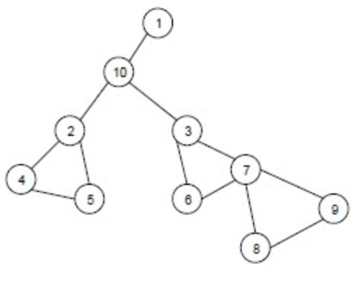
Bridges
Example
Input | Output
10 12 1 10 10 2 10 3 2 4 4 5 5 2 3 6 6 7 7 3 7 8 8 9 9 7 | 4 3 Explain: Articulation points: 10, 2, 3, 7 Bridges: (2-10), (10-3), (10-1)

Slide 5
Bridges
Idea to solve: DFS
Store graph in adjacency list: vector<vector<int>> adj(N);

Slide 6
Bridges
DFS
DFS tree and Num, Low structure
Finding bridges
Finding articulation points

Slide 7
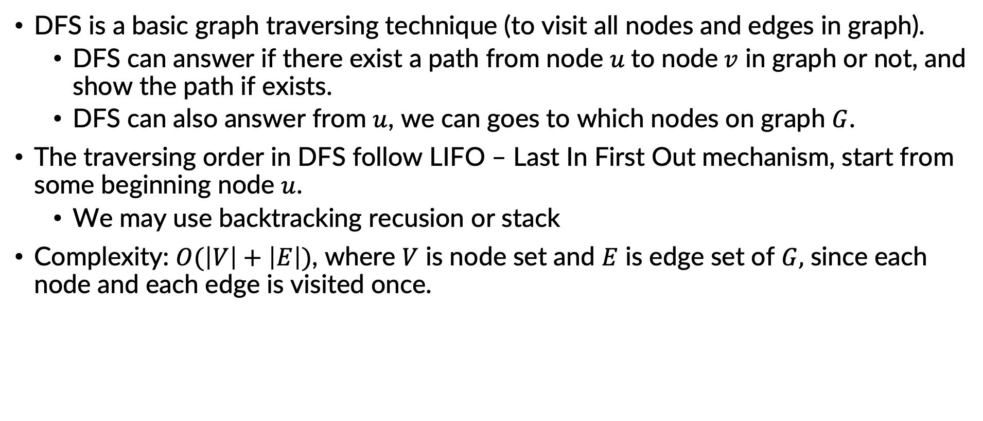
Depth First Search
DFS is a basic graph traversing technique (to visit all nodes and edges in graph).
DFS can answer if there exist a path from node $u$to node$v$ in graph or not, and show the path if exists.
DFS can also answer from $u$, we can goes to which nodes on graph $G$.
The traversing order in DFS follow LIFO – Last In First Out mechanism, start from some beginning node $u$.
We may use backtracking recusion or stack
Complexity: $O(\left|V\right|+\left|E\right|)$, where $V$ is node set and $E$ is edge set of $G,$ since each node and each edge is visited once.

Slide 8
Programming
Graph G = (V, E) represented by adjacency lists A[1…n]
Marking array:
visited[u] = true, if u is visited
visited[u] = false, otherwise
DFS(u) {
visit(u); // assign visited[u] = true
for v in A[u] do {
if not visited[v] then {
DFS(v);
}
}
}
DFS(){
for u in V do { visited[u] = false; }
for u in V do {
if not visited[u] then
DFS(u);
}
}

Slide 9
Bridges
DFS
DFS tree and Num, Low structure
Finding bridges
Finding articulation points

Slide 10
DFS tree
Trace of the DF search will construct a tree, called DFS tree
a
a
b
f
b
f
c
g
c
g

Slide 11
DFS tree
Trace of the DF search will construct DFS tree
Some type of edge in DFS:
Tree Edge: edge in DFS tree, e.g. black edges in figure
Back Edge: edge from descendants to ancestors, e.g. red edges
Forward Edge: edge from ancestors to descendants, e.g. blue edges
Crossing Edge: edge between non-relational nodes, e.g. purple edges
a
b
f
c
g

Slide 12
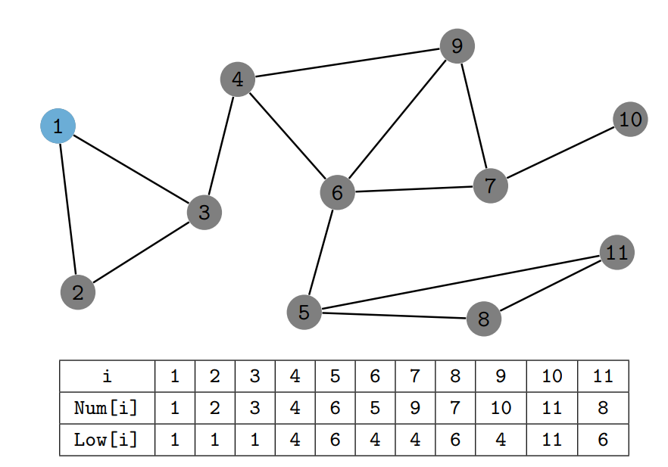
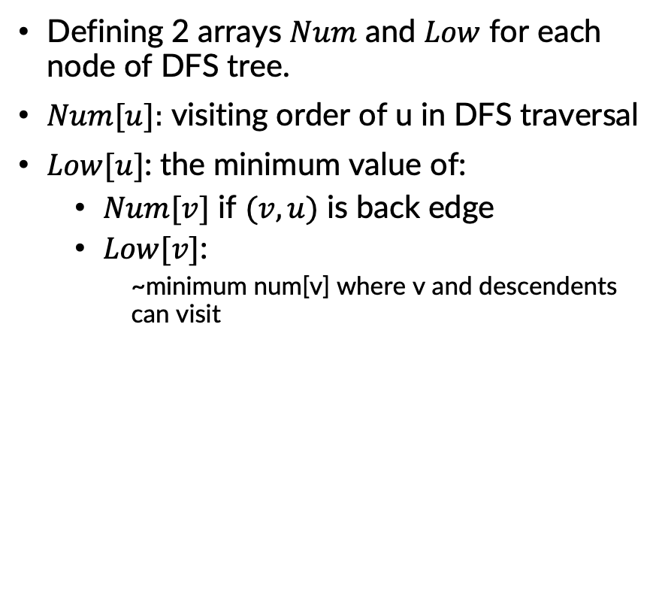
DFS tree: Num and Low structure
Defining 2 arrays $Num$ and $Low$ for each node of DFS tree.
$Num[u]:$ visiting order of u in DFS traversal
$Low[u]$: the minimum value of:
$Num[v]$ if $(v,u)$ is back edge
$Low[v]$:
~minimum num[v] where v and descendents can visit

Slide 13
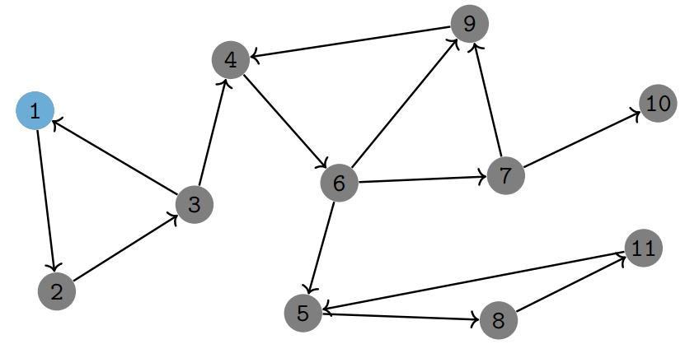
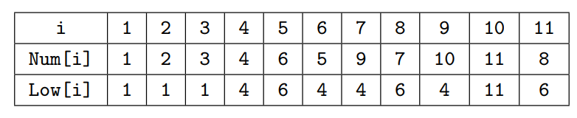
Example

Slide 14
DFS and Num, Low programming by recursion
p[v]: father of v in DFS
Num[u] = 0: node u is not visited
Num[u] > 0: node u is visited and Num[u] is the order
DFS(u) {
T += 1; Num[u] = T; Low[u] = T;
for v in A[u] do {
if v = p[u] continue;
if Num[v] > 0 then { // v was visited
Low[u] = min(Low[u], Num[v]);
} else {
p[v] = u;
DFS(v);
Low[u] = min(Low[u], Low[v]);
}
}
}

Slide 15
Bridges
DFS
DFS tree and Num, Low structure
Finding bridges
Finding articulation points

Slide 16
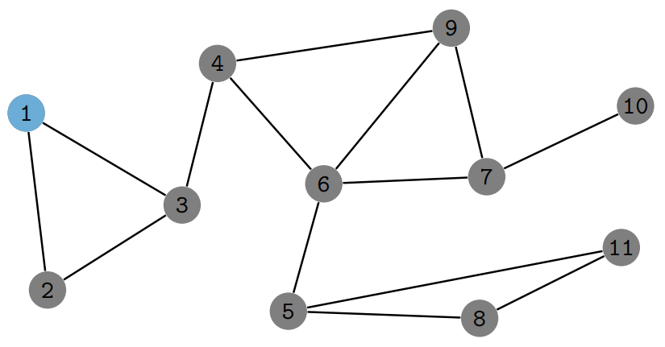

Finding bridges
Definition: Bridge is an edge where if we remove it, the number of connected components in the graph increases.
Note: A forwarde edge$(u,v)$ is an edge if and only if $Low[v] > Num[u]$

Slide 17
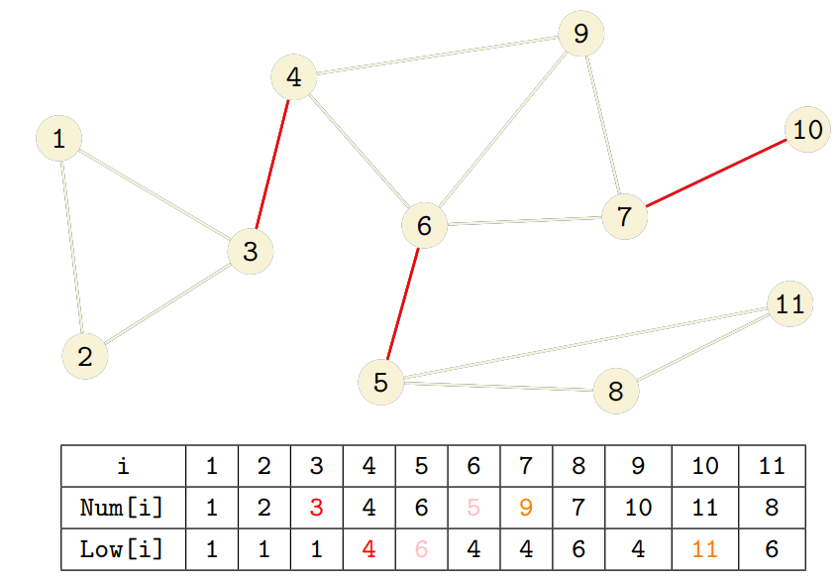
Finding bridges
Note: A forwarde edge$(u,v)$ is an edge if and only if $Low[v] > Num[u]$

Slide 18
Programming
p[v]: father of v in DFS
Num[u] = 0: node u is not visited
Num[u] > 0: node u is visited and Num[u] is the order
update low[u]
check bridge (u,v)
DFS(u) {
T += 1; Num[u] = T; Low[u] = T;
for v in A[u] do {
if v = p[u] continue;
if Num[v] > 0 then { // v was visited
Low[u] = min(Low[u], Num[v]);
} else {
p[v] = u;
DFS(v);
Low[u] = min(Low[u], Low[v]);
if Low[v] > Num[u] then (u,v) is a bridge;
}
}
}

Slide 19
Bridges
DFS
DFS tree and Num, Low structure
Finding bridges
Finding articulation points

Slide 20
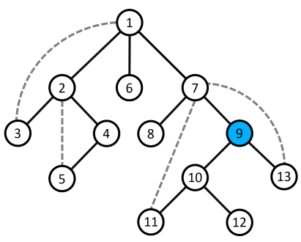
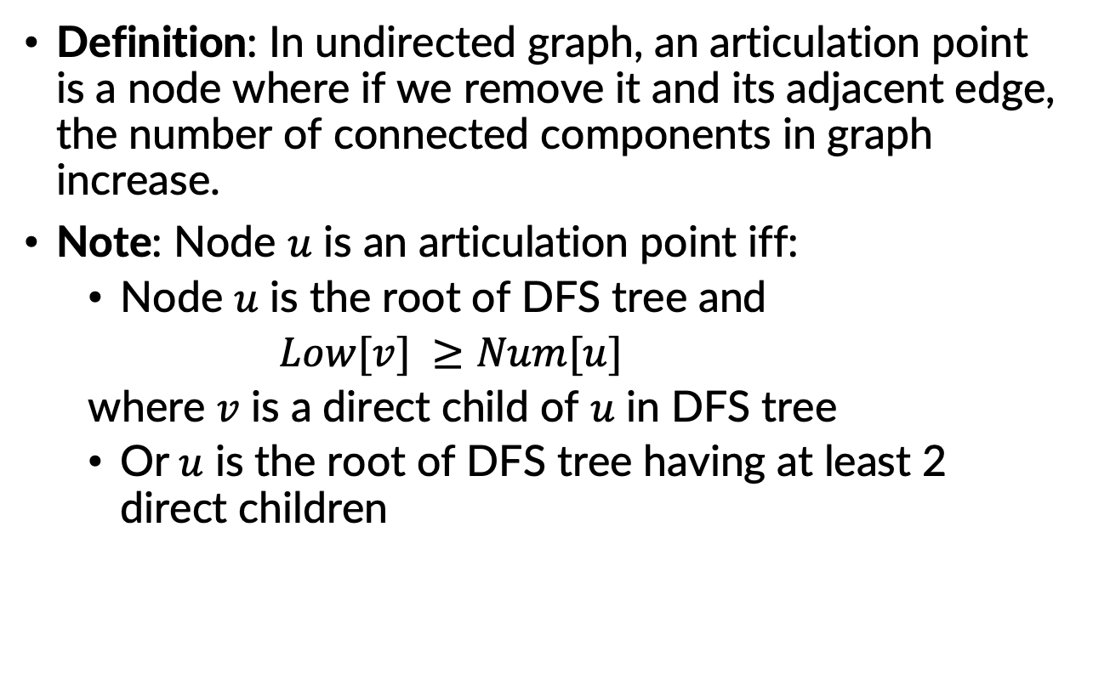
Finding articulation points
Definition: In undirected graph, an articulation point is a node where if we remove it and its adjacent edge, the number of connected components in graph increase.
Note: Node $u$ is an articulation point iff:
Node $u$ is the root of DFS tree and
$Low[v] ≥Num[u]$
where $v$ is a direct child of $u$ in DFS tree
Or$u$ is the root of DFS tree having at least 2 direct children

Slide 21
THANK YOU !

